Slide 1
The Precautionary Approach in Coastal/Ocean Governance: Beacon of Hope, Seas of Confusion and Challenges
Professor David L. VanderZwaag
Canada Research Chair in Ocean Law and Governance
Marine & Environmental Law Institute
Dalhousie University
China-ASEAN Academy on Ocean Law and Governance
National Institute for South China Sea Studies
Haikou, Hainan, China
November 10, 2016

Slide 2
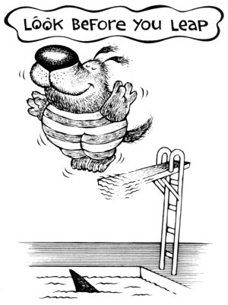
Introduction
The Precautionary Approach/Principle Sounds Simple, Straightforward and Seems To Be Here To Stay!
Captures common sense notions evident in many cultures
An ounce of prevention is worth a pound of cure
A stitch in time saves nine
Look before you leap
Better safe than sorry
Provides critical guidance for making environmental decisions
Where there is scientific uncertainty as to environmental effects of a
proposed exploitation/use, decision-makers should “err on the side
of caution”
Seems here to stay
Precautionary principle/approach has been embraced in over 50 international legally-binding agreements and over 40 non-binding instruments

Slide 3
Examples include:
Montreal Protocol on Ozone Depleting Substances (1987)
UN Framework Convention on Climate Change (1992)
Convention on Biological Diversity (1992)
FAO Code of Conduct for Responsible Fisheries (1995)
UN Agreement on Straddling and Highly Migratory Fish Stocks (1995)
Cartagena Biosafety Protocol (2000)
Stockholm Convention on Persistent Organic Pollutants (2001)
Rio Declaration on Environment and Development (1992)
World Summit on Sustainable Development (WSSD) Plan of Implementation (2002)

Slide 4
Three Nautical Images Help Capture How the Precautionary Approach/ Principle Has Been Faring in Governance Practice
1. Beacon of Hope
2. Sea of Confusion
3. Sea of Challenges

Slide 5
1. Beacon of Hope
The precautionary principle/approach may be
likened to a lighthouse beacon with various
potentially powerful beams for avoiding the
shoals of depleted resources, losses of
biodiversity and harm to the marine environment
Placing the Burden of Proof on Proponents of Development/Change
No approval should be granted unless the proponent establishes some standard of safety/acceptability
Examples of standards
No significant damage to the marine environment
No serious or irreversible harm to marine biodiversity
No unreasonable adverse effects on the marine environment

Slide 6
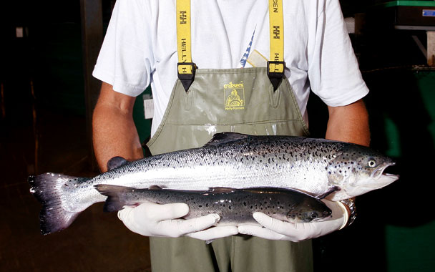
Establishing Prohibitions (For Example, No Deliberate Introduction of Non-Indigenous Species, No Import or Production of Genetically Modified Organisms)
Imposing Zero Discharge or Virtual Elimination Standards at Least for Toxic Substances That Are Persistent and Bioaccumulate
Adopting “Reverse Listing” Where Only Substances Listed as Safe Can Be Manufactured or Marketed
http://www.naturalindependent.com/wp-content/uploads/2012/12/gmsalmon.jpg

Slide 7
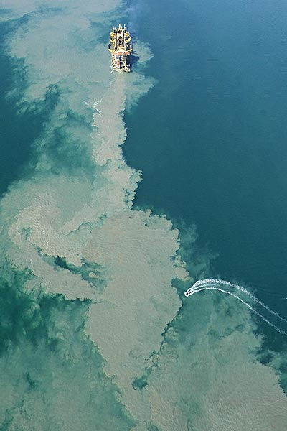
Legal “Revolution” to Strong Version Seen in Ocean Dumping Field
London Convention 1972 favours polluters and is permissive in approach
Anything can be dumped with a permit except
substances on a “prohibited list”
Mercury
Cadmium
Organohalogen compounds
Persistent plastics
Various oils
Biological and chemical warfare materials
Radioactive wastes
Industrial wastes
Incineration at sea of industrial wastes and sewage sludge

Slide 8
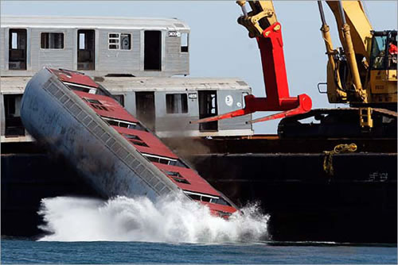
1996 Protocol to London Convention adopts “reverse listing” approach where listing favours the environment and is precautionary
Nothing can be dumped unless it is listed on a “safe list”
Dredged material
Sewage sludge
Fish wastes
Vessels and platforms or other man-made structures
Inert, inorganic geological material
Organic materials of natural origin
Bulky items primarily comprising iron, steel, concrete, and similarly unharmful materials for which concern is physical impact (limited to where wastes are generated at locations having no practicable access to disposal options other than dumping)
Sequestration of carbon dioxide (CO₂) under the seabed

Slide 9
Even for waste on the “safe list”, Annex 2 of the Protocol further encourages a precautionary approach through the permitting process
The permitting authority is encouraged to require ocean dumping applicants to undertake waste prevention audits
Whether waste reduction/prevention at source is feasible, for example, through product reformulation, clean production technologies
If so, applicants should be required to formulate a waste prevention strategy and waste reduction/prevention requirements should be included as permit conditions
Permitting authority is obligated to refuse issuing a permit if appropriate opportunities exist to re-use, recycle or treat the waste without undue risks to human health or the environment or disproportionate costs
The permitting authority is also urged to deny an ocean dumping permit if an environmental assessment does not include adequate information to determine the likely effects of the proposed disposal

Slide 10
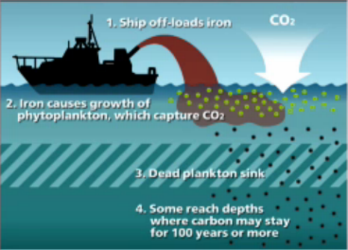
In October 2013, Parties to the 1996 Protocol adopted further amendments to ensure a precautionary approach to future marine engineering intervention, especially ocean fertilization
New Annex 4 prohibits ocean fertilization activities except for legitimate scientific research
Such proposed scientific research must undergo a detailed environmental assessment with specifics set out in a new Annex 5 before a permit is granted
Permits to be issued only if the assessment determines that the pollution of the marine environment is as far as practicable prevented or reduced to a minimum
Additional geoengineering activities may be added to Annex 4 for precautionary controls

Slide 11
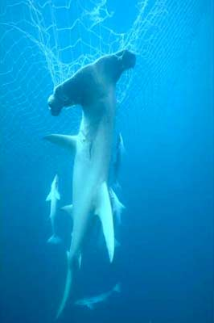
The Reverse Onus of Proof Approach in International Fisheries Has Been Adopted on Occasion in Rather Narrow Circumstances
This “powerful beam” version of precaution in international fisheries is exemplified by the banning of large scale driftnets on the high seas
Moratoria on all large-scale pelagic driftnet fishing urged to be implemented by all States with moratoria lifting dependent on demonstration of effective conservation and management measures and ensurance of conservation of living marine resources (UN GA Res. 44/225 adopted December 1989)
Global moratorium on all large-scale pelagic driftnet fishing to be fully implemented on the high seas, including enclosed and semi-enclosed seas by 31 December 1992 (UN GA Res. 46/215 adopted 20 December 1991)
http://weblog.greenpeace.org/deep sea/images/hammerhead_grace.jpg

Slide 12
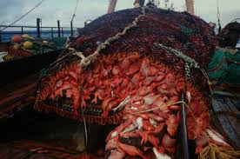
The global community has also adopted a form of burden of proof reversal to bottom fishing activities
Through UN Sustainable Fisheries Resolution 61/105 in December 2006
Called upon Regional Fisheries Management Organizations or Arrangements (RFMO/As)
To close vulnerable marine ecosystems (VMEs), including seamounts, hydrothermal vents and cold water corals, to bottom fisheries
To ensure bottom fishing activities do not proceed unless conservation and management measures have been established to prevent significant adverse impacts on VMEs
Urged States negotiating new RFMO/As, such as in the South Pacific, to adopt like precautionary measures on an interim basis

Slide 13
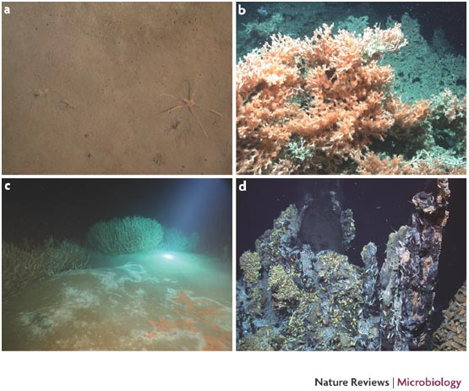
Through International Guidelines for the Management of Deep-sea Fisheries on the High Seas (2008) States and RFMO/As are urged to close VMEs until appropriate conservation and management measures have been adopted
To prevent significant adverse impacts
To ensure long-term conservation and sustainable use of deep-sea fish stocks
http://www.nature.com/nrmicro/journal/v5/n10/images/nrmicro1745-i1.jpg

Slide 14
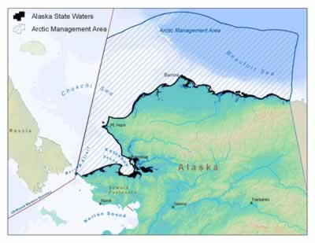
Precaution Has Potential To Also Powerfully Guide Governance within Nations
Example of North Pacific Fishery Management Council in the USA imposing a precautionary moratorium on commercial fisheries in Arctic waters off Alaska (Pursuant to a 2009 Arctic Fishery Management Plan)
Moratorium in effect until further scientific information is available on the fish stocks and their ecosystems

Slide 15
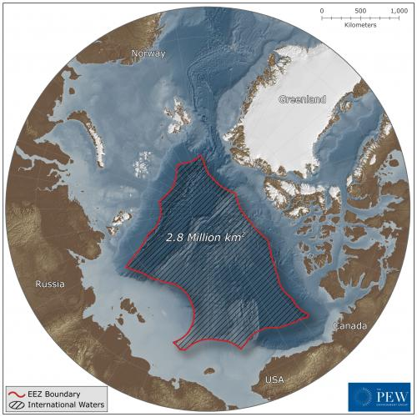
“Precautionary Moratorium” Has Also Been Extended to the Central Arctic Ocean (CAO)
The five Arctic coastal States adopted a Declaration Concerning the Prevention of Unregulated High Seas Fishing in the CAO at a meeting in Oslo, Norway on July 16, 2015
States agreed to interim measures to address potential commercial fishing in the high seas of the CAO
Not authorizing fishing vessels to conduct fishing in the high seas area until one or more regional or subregional fisheries management organizations or arrangements have established management measures
Establishing a joint scientific research program to promote ecosystem understandings
The Arctic 5 have expanded CAO precautionary fisheries discussions to include 5 other entities (China, Japan, South Korea, Iceland and the EU)

Slide 16
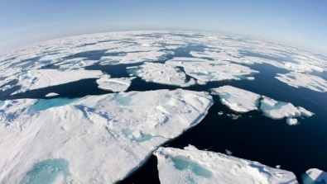
Initial meeting of the “5 + 5” occurred in Washington DC, 1-3 December 2016 where delegations
Expressed the desire to cooperate in advancing scientific research and monitoring for the CAO
Considered various possible approaches to prevent unregulated commercial fishing in the CAO high seas including
Adoption of a broader non-binding declaration on CAO fisheries
Negotiation of a binding international agreement as proposed by the United States
Negotiation in the foreseeable future of an agreement or agreements to establish one or more additional regional fisheries management organizations or arrangements for the area
Further policy meetings occurred on 19-21 April 2016 in Washington, DC and 6-8 July 2016 in Iqaluit

Slide 17
2. Sea of Confusion
Various confusing currents (“quick eight”)
Definitional Generalities
Definitional Variations
Uncertainty in Terminology
Wide Spectrum of Precautionary Management Measures Available
Differing Academic Views on Implications
Limited and Varied Interpretations by National Tribunals/Courts
Limited Interpretations by International Tribunals/Courts
Ongoing Ethical Clashes over How Precautionary Societies Should Be

Slide 18
Definitional Generalities
For example, Rio Declaration, Principle 15
In order to protect the environment, the precautionary approach shall be widely applied by States according to their capabilities. Where there are threats of serious or irreversible damage, lack of full scientific certainty shall not be used as a reason for postponing cost-effective measures to prevent environmental degradation.
Definition leaves considerable interpretive leeways
What exactly are State capabilities?
How should serious or irreversible damage be defined?
What should be the role of science in determining risks?
What are cost-effective measures?

Slide 19
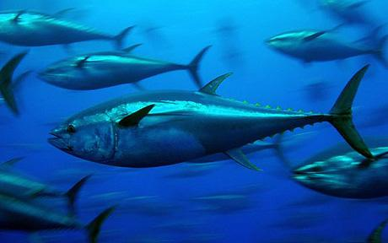
Definitional generality also hovers over international fisheries law, e.g.,
UN Agreement on Straddling and Highly Migratory Fish Stocks (1995) provides:
States shall be more cautious when information is uncertain, unreliable or inadequate. The absence of adequate scientific information shall not be used as a reason for postponing or failing to take conservation and management measures (Art. 6(2))
FAO Code of Conduct for Responsible Fisheries (1995) urges: States should apply the precautionary approach widely to conservation, management and exploitation of living aquatic resources in order to protect them and preserve the aquatic environment. The absence of adequate scientific information should not be used as a reason for postponing or failing to take conservation and management measures (para. 7.5.1)

Slide 20
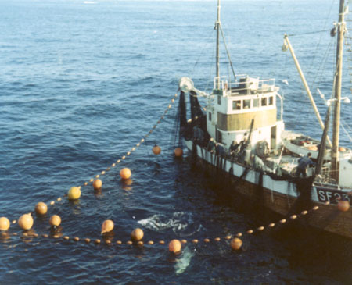
FAO Technical Guidelines on the Precautionary Approach to Capture Fisheries and Species Introductions (1996) also overflow with generalities
No clear allocation of burden of proof
Technical Guidelines call for “appropriate placement of the burden of proof” (para. 6(h)).
Vague guidance on standard of proof
Technical Guidelines provide the standard of proof “should be commensurate with the potential risk to the resource, while also taking into account the expected benefits of the activities” (para. 7(d)).

Slide 21
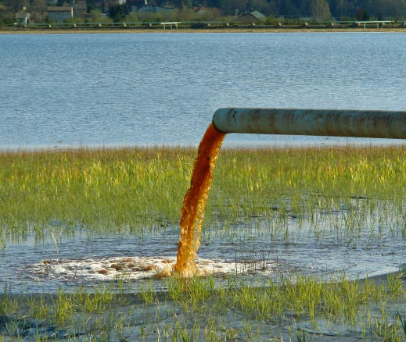
Definitional Variations
The “trigger” for precaution
Threats of serious or irreversible damage (Rio Declaration)
Likely to cause damage or harm (North Sea Ministerial Declarations)
The “scope” of activities covered
Toxic, persistent, bioaccumulative substances (1987 London Declaration)
All policy sectors (1990 Bergen Declaration on Sustainable Development)
In order to achieve sustainable development, policies must be based on the precautionary principle. Environmental measures must anticipate, prevent, and attack the causes of environmental degradation. Where there are threats of serious or irreversible damage, lack of full scientific certainty shall not be used as a reason for postponing measures to prevent environmental degradation.

Slide 22
The “cost-effective” limitation
Rio Declaration calls for cost-effective measures
Biodiversity Convention does not include the cost-effective limitation
Noting also that where there is a threat of significant reduction of
loss of biological diversity, lack of full scientific certainty should
not be used as a reason for postponing measures to avoid or
minimize such a threat… (Preamble)

Slide 23
Uncertainty in Terminology
Approach vs. principle?
Is there a difference?
No - The terms are interchangeable (for example, Rio Declaration uses both terms)
Yes - The term approach is preferable because it
Better connotes the non-legally binding nature (US and Canada preference in Beef Hormones Case (1998) before the WTO Appellate Body)

Slide 24
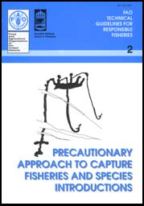
Avoids extreme applications (FAO preference to avoid fishing moratoria and reversal in burden of proof to fishers to show “no harm”)
FAO Technical Guidelines on Precautionary Approach state: “[A]lthough the precautionary approach to fisheries may require cessation of fishing activities that have potentially serious adverse impacts, it does not imply that no fishing can take place until all potential impacts have been addressed and found to be negligible” (para.7(b)).

Slide 25
Wide Spectrum of Precautionary Management Measures
Not just strong versions such as reversal in the “burden of proof”
Weaker versions also, e.g.,
Mandating regulators to apply the precautionary approach
Requiring polluters to develop pollution prevention plans as a precondition to licensing
Imposing a best available technology standard
Following an adaptive management approach (learn by doing)
Setting cautious standards to limit impacts (for example, margins of safety to protect children’s health)
Placing the burden on regulators to justify taking precautionary measures through scientific risk assessment

Slide 26
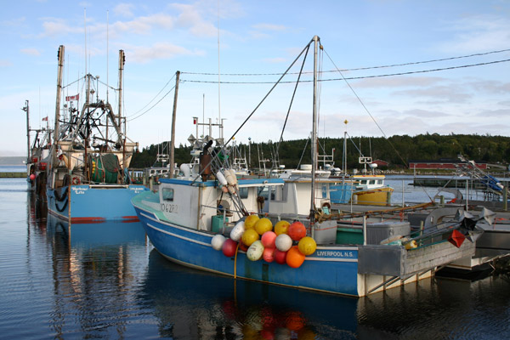
A menu of fisheries management measures
Setting cautious quotas (For example, catch limits so as not to reduce average biomass of target/non-target species by more than 20%)
Terminating open access fisheries and developing management plans within certain time frames
Promoting selective fishing gears/methods
Requiring EIAs before opening new fisheries
Allowing fish to spawn at least once
Establishing limited take marine protected areas

Slide 27
1995 UN Fish Stocks Agreement (Annex II) urges application of precautionary reference points to manage straddling and highly migratory stocks
Limit reference points
Conservation thresholds that should not be exceeded to ensure harvesting is within safe biological limits
Maximum sustainable yield should be regarded as a minimum standard for limit reference points
Example would be setting a precautionary level for spawning stock biomass below which it should not fall

Slide 28
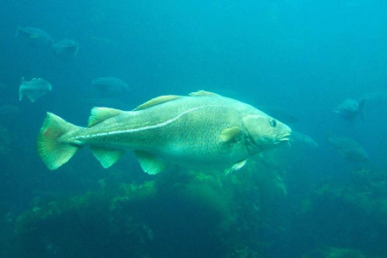
Target reference points
Intended to meet management objectives
No examples of types of management objectives given
Example might be setting a target of returning a stock biomass to a healthy historical level
Precautionary reference points shall be used to trigger pre-agreed conservation and management actions (for example, a recovery plan where a stock falls below the limit reference point)

Slide 29
Differing Academic Views on Implications
Enthusiastic and “little doubt” about precautionary approach in environmental governance
Richard C. Hildreth et al.
[The precautionary approach entails a reversal of the burden of proof. Reversing the burden of proof requires shifting the burden from those who seek to regulate an activity to those who propose and would benefit from the activity.
(“Roles for a Precautionary Approach in Marine Resources Management” (2005) 19 Ocean Yearbook 33, 36).

Slide 30
Skeptical and “lots of doubt” about PP providing guidance
Jaye Ellis and Alison FitzGerald
The precautionary principle “does not tell decision-makers or individual actors what to do or when; it does not reverse the burden of proof; and it does not place environmental concerns ahead of social and economic ones.”
(“The Precautionary Principle in International Law: Lessons from Fuller’s Internal Morality” (2004) 49 McGill L.J. 779, 782)
Authors have lamented over the literary explosion and confusion
Jaye Ellis, “Overexploitation of a Valuable Resource? New Literature on the Precautionary Principle”17 European Journal of International Law 445-462.
Arie Trouwborst, “The Precautionary Principle in General International Law: Combating the Babylonian Confusion” (2007) 16 RECIEL 185-195.

Slide 31
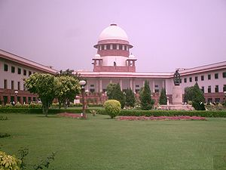
Limited and Varied Interpretations by National Tribunals/Courts
Courts in majority of countries have yet to address interpretation and jurisprudential implications of the precautionary principle/approach
Varied national interpretations/approaches to precaution with courts/ tribunals displaying a spectrum from strong to weak embraces (over 200 cases in Commonwealth countries alone)
Example of strong embrace
India Supreme Court case – The high point of judicial activism
Case Against Cultured Shrimp (S. Jagannath v. Union of India and Others, [1996] INSC1629 (11 December 1996)
Public interest lawsuit brought by non- governmental organization, seeking to
Ensure enforcement of a national coastal zone regulation prohibiting intensive shrimp culture farms within 500 metres of the high tide mark

Slide 32
Force application of pollution control and environmental assessment laws to commercial shrimp farms outside the prohibited zone
Supreme Court of India enthusiastically embraced the precautionary principle
Indicated that the precautionary principle is an essential feature of the concept of sustainable development which has been accepted as part of customary international law (though its salient features have yet to be finalized by international law jurists)

Slide 33
Interpreted what the precautionary principle means in the context of domestic law
Governmental environment measures must anticipate, prevent and attack the causes of environmental degradation
Where there are threats of serious and irreversible damage, lack of scientific certainty should not be used as a reason for postponing measures to prevent environmental degradation
The “onus of proof” is on the actor or the developer/
industrialist to show that his/her action is environmentally benign

Slide 34
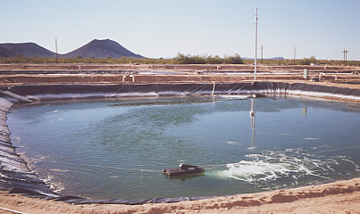
Issued various orders/directions including
Removal of all shrimp culture ponds from 500 metre coastal prohibited zone
Establishment by the central government of a regulatory authority to ensure precautionary pollution controls and EIA of shrimp industrial developments outside the prohibited area

Slide 35
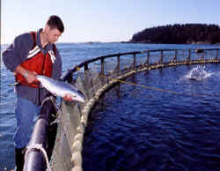
Case representing “weak” version of precaution
Homalco Indian Band v. British Columbia (Minister of Agriculture, Food and Fisheries) (2005), 39 B.C.L.R. (4th) 263 (British Columbia Supreme Court)
Indian band challenged governmental grant of approval to raise Atlantic salmon on a fish farm instead of previously stocked Pacific salmon
Grounds of challenge included government failure to adequately consult with the Indian band and failure to properly apply the precautionary principle

Slide 36
Indian band argued strong “reverse onus” approach to precaution
No approval of farming Atlantic salmon should be granted until the British Columbia ministry and industry proponent can prove there is no risk to wild salmon
Gaps in scientific knowledge and research make such proof impossible
Therefore, no approval should be allowed

Slide 37
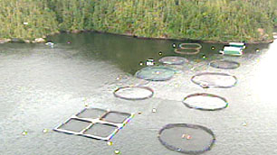
British Columbia Ministry and aquaculture proponent argued
Against a strong “reverse onus” approach
In favour of a weakened version
“[T]he principle really means that lack of scientific knowledge is not a basis for failing to pass regulations or controls to avoid potential serious or irreversible damage to the environment”
We have already passed precautionary regulations, for example, regarding escape prevention requirements through technical standards for net pens

Slide 38
British Columbia Supreme Court agreed with the government/industry position on precaution
The precautionary principle does not require governments to halt all activity which may pose some risk to the environment until that can be proven otherwise
The decisions on what activity to allow and how to control it often require a balancing of interests and concerns and a weighing of risks. Court suggested an adaptive management approach would be a proper means of accommodation which should be the topic of further discussions/consultations

Slide 39
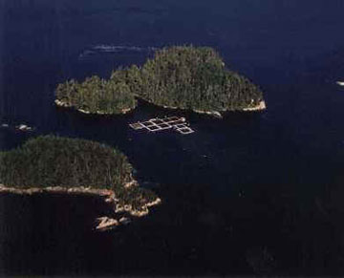
British Columbia Court found there had not been adequate consultation with the Indian band
Court left it to Department of Fisheries and Oceans to
further consult with the Indian band
http://www.agf.gov.bc.ca/fisheries/images/bcsalm1.jpg

Slide 40
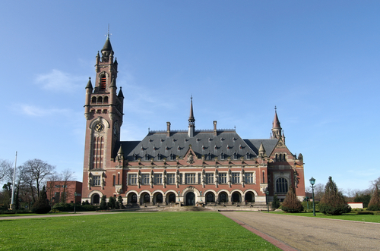
Limited Interpretation by International Tribunals/Courts, Five Quick Examples
Nuclear Tests (New Zealand v. France) (International Court of Justice (ICJ), 1995)
Proposed underground nuclear testing in the South Pacific by France
New Zealand seeking to reopen its previous case against France in 1973/74
ICJ judgment of 20 December 1974, dealing with French atmospheric nuclear testing, left open the possibility of litigative resumption if the judgment was “to be affected” by subsequent events
France had withdrawn its acceptance of compulsory ICJ jurisdiction in 1974

Slide 41
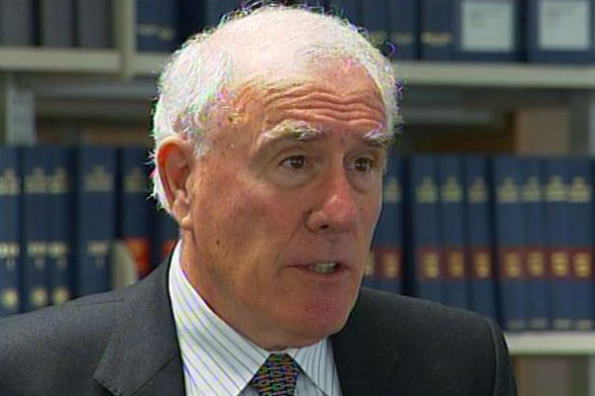
New Zealand arguing precautionary principle meant French obligation to
Undertake an EIA before nuclear testing
French burden of proof to demonstrate no environmental contamination
No decision on merits because of lack of jurisdiction
Dissenting opinion of Geoffrey Palmer suggested the precautionary principle may be a principle of customary international law but did not flesh out what the content might be

Slide 42
Southern Bluefin Tuna Case(s) (International Tribunal for the Law of the Sea (ITLOS), August 1999)
Australia and New Zealand arguing Japan should be stopped, based on the precautionary principle, from unilaterally increasing catch levels of southern bluefin tuna
Tribunal did not expressly address the precautionary principle but gave it an “implicit” mention
[I]n the view of the Tribunal the parties should in the
circumstances act with prudence and caution to ensure that effective conservation measures are taken to prevent serious harm to the stock of southern bluefin tuna … (para. 77)

Slide 43
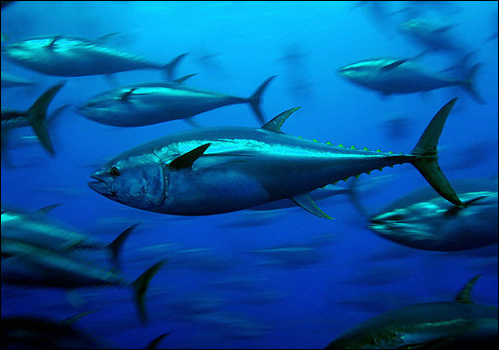
Tribunal’s Order
Required Japan to refrain from further “experimental fishing” except with agreement of parties or under experimental catch counted against its annual quota)
Encouraged resumption of negotiations among the parties with a view of reaching agreement on conservation and management measures
Encouraged Australia, Japan and New Zealand to make further efforts at reaching an agreement with other States and fishing entities engaged in southern bluefin fishing

Slide 44
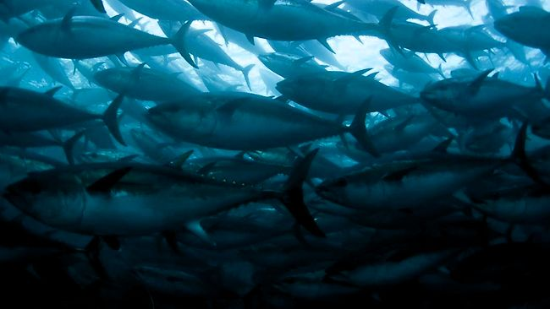
Two judges (Shearer and Laing) in separate opinions indicated the provisional measures ordered were based on precaution.
Judge Laing raised question of whether the precautionary principle should reverse onus of proof to the party wishing to increase catch levels, but felt question should be left to full arbitration.
Arbitral Tribunal ultimately declined jurisdiction (Award of 4 August 2000).

Slide 45
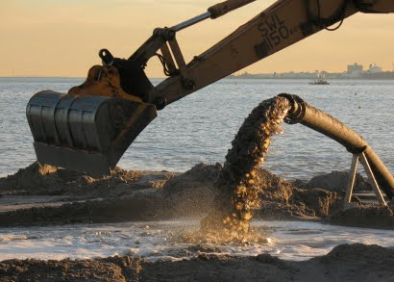
Case Concerning Land Reclamation by Singapore in and around the Straits of Johor (Malaysia v. Singapore) (ITLOS, 2003)
Malaysia seeking provisional measures requiring Singapore to suspend land reclamation activities, to provide full information about the projected works, to afford Malaysia full opportunity to comment upon the works and to negotiate with Malaysia concerning unresolved issues
Malaysia arguing various breaches of the 1982 Law of the Sea Convention provisions including failure to undertake an adequate environmental impact assessment
Malaysia also argued breach by Singapore of the precautionary principle under International Law

Slide 46
The Law of the Sea Tribunal avoided detailed addressing of the precautionary principle
Simply noted that the possible implications of land reclamation on the marine environment required “prudence and caution” whereby Malaysia and Singapore must establish mechanisms for exchanging information assessing the environmental risks or effects and devising ways to deal with the environmental impacts
Tribunal prescribed provisional measures
Calling upon Malaysia and Singapore to cooperate and to enter into consultations in order to promptly establish a group of independent experts to study the effects of Singapore’s land reclamation and to propose measures to address any adverse effects
Directing Singapore not to conduct its land reclamation in ways that might cause serious harm to the marine environment

Slide 47
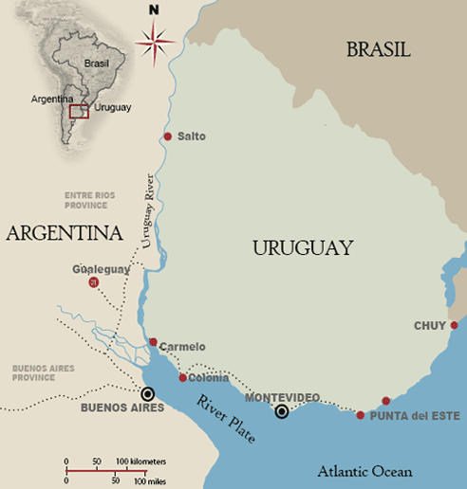
Case Concerning Pulp Mills on the River Uruguay (Argentina v. Uruguay) (ICJ, 2010)
Argentina contesting the construction of two pulp mills in Uruguay on a transboundary river
Various procedural violations of the Statute of the River Uruguay (1975 Treaty) argued including shortcomings in notifications and consultations
Various substantive obligation breaches also argued such as the prevention of pollution
Argentina, as a key proposition, argued the precautionary approach should place the burden of proof on Uruguay to establish that the mills will not cause significant damage to the environment

Slide 48
The majority of the ICJ, avoiding any detailed discussion of the precautionary approach, simply concluded in para. 164
A precautionary approach may be relevant in the interpretation and application of the provisions of the Statute
It does not follow that the precautionary approach operates as a reversal of the burden of proof

Slide 49
Judge Cancado Trindade, in a Separate Opinion, lamented over the missed opportunity for the ICJ to affirm and elaborate on the general principles of International Environmental Law
“It escapes my comprehension why the ICJ has so far had so much precaution with the precautionary principle” (para. 67)
He did delve into detailed discussion on the legal sources and parameters of key principles such as prevention and precaution
He opened up a “fundamental question” regarding the jurisprudential sources of the precautionary principle:
Is the precautionary principle based upon natural law?
The third major source of international law recognized in Art. 38 of the Statute of the International Court of Justice is general principles of law recognized by civilized nations

Slide 50
Scholarly debate has occurred over whether that category opens the door to principles derived from outside state consent and negotiation
General principles based upon human reason and common sense
General principles recognizing the laws of nature (environmental limits and thresholds)
Some scholars have viewed the category as limited to drawing out legal principles common in domestic legal systems around the globe

Slide 51
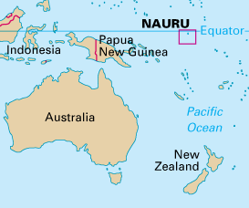
Advisory Opinion on Responsibilities and Obligations of States Sponsoring Persons or Entities with Respect to Activities in the Area (Seabed Disputes Chamber, ITLOS, 2011)
At the request of Nauru, the Council of the International Seabed Authority (ISA) requested an advisory opinion regarding the legal responsibilities and extent of liability of States sponsoring deep seabed mineral activities

Slide 52
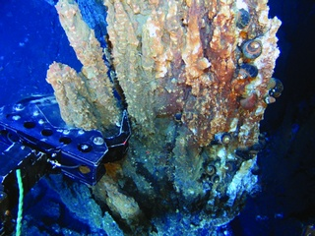
The Chamber noted that the two sets of Regulations adopted by the ISA on prospecting and exploring for polymetallic nodules (2000) and for polymetallic sulphides (2010) both require sponsoring States to apply a precautionary approach, as reflected in Principle 15 of the Rio Declaration, in order to ensure effective protection for the marine environment from harmful effects which may arise from activities in the Area (para. 125)
The Chamber did not provide a detailed discussion or jurisprudential analysis of the precautionary approach
The Chamber merely noted the various questions of interpretation left open by the Principle 15 text, such as “serious or irreversible damage”, “cost-effective measures” (paras. 128, 129)

Slide 53
The Chamber indicated that the precautionary approach is also an integral part of the general obligation of due diligence of sponsoring States, which is applicable even outside the Regulations:
This obligation applies in situations where scientific evidence covering the scope and potential negative impact of the activity in question is insufficient but where there are plausible indications of potential risks. A sponsoring State would not meet its obligations of due diligence if it disregarded those risks. Such disregard would amount to a failure to comply with the precautionary approach. (para. 131)
The Chamber further observed that in light of the growing number of treaties and other instruments incorporating the precautionary approach, “This has initiated a trend towards making this approach part of customary international law.” (para. 135)

Slide 54
Ongoing Ethical Clashes Over How Precautionary Societies Should Be
Ethical clashes are at heart of many environmental disputes
Eco-centric world views
Wishing to impact nature as little as possible
Being risk adverse
Questioning or rejecting use of cost-benefit or risk-benefit analysis in decision-making
Advocating fundamental human rights, for example, right to clean, healthy environment

Slide 55
Utilitarian mindsets
Viewing nature as set of resources to be exploited
Supporting risk taking
Placing “great faith” in science and technology
Favouring cost-benefit and risk-benefit analysis
Willing to trade off environmental values for socio-economic gains

Slide 56
Various terms describe ethical tensions, for example
Immanent vs. transcendent
Prohibitory vs. regulatory
Trial without error vs. trial and error
Deep green vs. light/shallow green
“Organic” mentality vs. better living through chemistry (biology)
Ethical viewpoints in a struggle to interpret precaution strongly vs. weakly

Slide 57
The beauty of precaution may be in the eye of the beholder
Those with eco-centric perspectives tend to see “wonderful beauty” in the precautionary principle
A shift towards an ecological society
Clean production processes
Environmentally friendly industries (for example eco-forestry, organic agriculture, eco-tourism)
Sustainable community economies (M’Gonigle 1999)
A liberation from expert systems and top-down decision-making
A just world where environmental values and human values are taken seriously

Slide 58
Those with utilitarian perspectives tend to see an “ugly concept” needing to be contained
Precaution may stifle innovation
Precaution may devalue or sideline science
Precaution may interfere with trade
Precaution may thwart development
Precaution may have paradoxical perils (for example by not allowing pest-resistant plant biotechnology, greater pesticide use may be encouraged)

Slide 59
Discussion Questions
Has the precautionary approach/principle been incorporated in your country’s laws and policies and if so, how?
What are the main constraints in national implementation of the precautionary approach/principle?

Slide 60
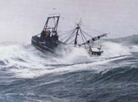
3. Sea of Challenges
Putting the Precautionary Approach into Practice Has Not Been Easy as Demonstrated in the Field of Fisheries Management
Practical and Political Realities Have Made for “Rough Sailing”

Slide 61
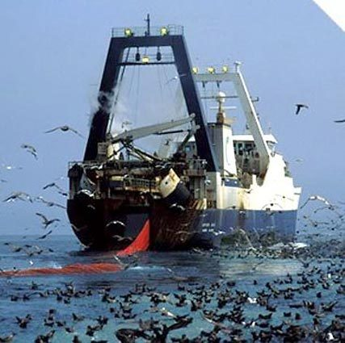
Practical constraints
Limited financing and human resources for research in support of setting reliable precautionary reference points
For 2015, only 57 per cent of the FAO Members reported sufficient personnel to generate data in support of sustainable fisheries management
Only 41-50 per cent of key national stocks are considered to have reliable estimates on stock status
Major knowledge gaps include
Stock status
Catch data and effort data
Ecosystem factors
Level of IUU fishing

Slide 62
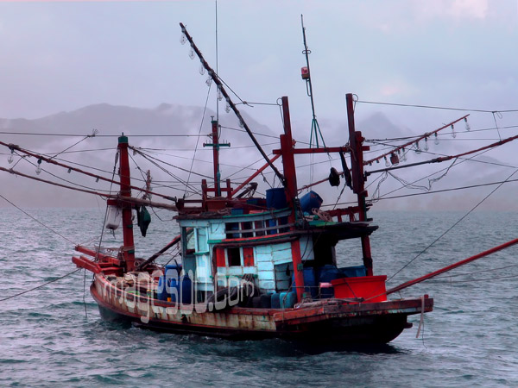
Political realities
Three political realities stand out in precautionary approach implementation at both the national and regional levels
Setting high total allowable catches even when scientific information is lacking or limited
Ignoring or over-riding precautionary scientific advice because of socio-economic pressures
Failing to legally require the following of precautionary scientific advice in establishing fisheries management measures

Slide 63
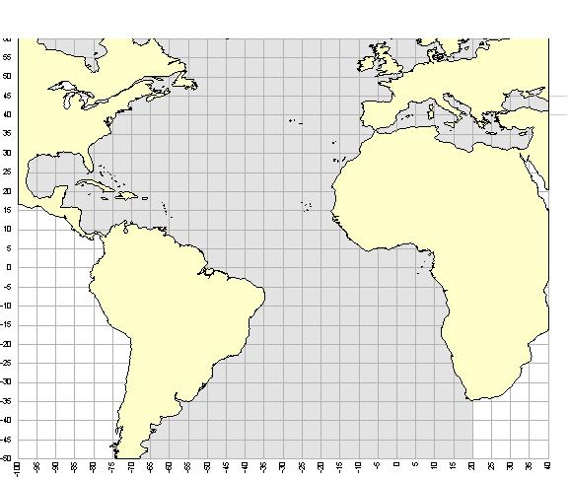
Implementation Difficulties Exemplified in the Attempts by Two Regional Fisheries Management Organizations to Manage Bluefin Tuna Stocks
International Commission for the Conservation of Atlantic Tunas
http://www.iccat.int/Images/misc/ConvArea.jpg

Slide 64
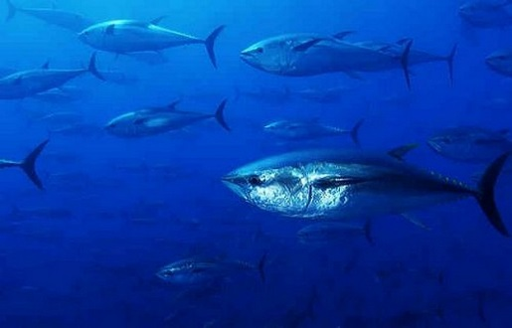
ICCAT placed precaution on the “radar screen” in the 1990s
The Ad Hoc Working Group on the Precautionary Approach was established in 1997 and a 1999 report made various recommendations to further facilitate implementation of the precautionary approach, e.g.,
Improving catch and bycatch information
Increasing funding at all levels including data collection, monitoring, enforcement and possibly large tagging experiments

Slide 65
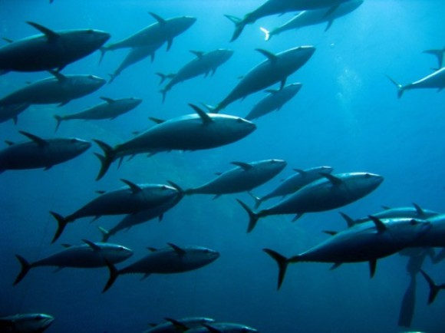
However, ICCAT has largely ignored precaution in practice
The ICCAT Convention is at odds with the precautionary approach advocated by the 1995 UN Fish Stocks Agreement
The Convention elevates maximum sustainable yield as the overall management target (the point to aspire to)
The Fish Stocks Agreement suggests MSY as a limit reference point (the point to avoid)

Slide 66
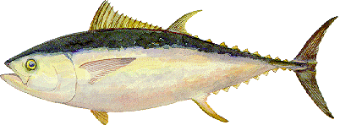
ICCAT notoriously failed for many years to follow its own scientific advice for conserving bluefin tuna in the Eastern Atlantic and Mediterranean Sea
In 2007, ICCAT scientists advised the short-term MSY catch level would be on the order 15,000 tonnes
SCRS scientists expressed great concerns regarding the over-fishing and under-reporting of bluefin catches and indicated the 2003-2004 mortality rate may have been more than three times the level permitting the stock to stabilize at the MSY reference point
http://www.iccat.int/Images/species/bft1.gif

Slide 67
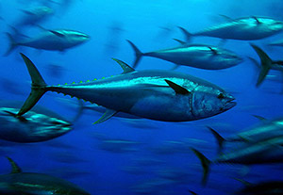
The Contracting Parties adopted a 15 Year recovery plan for bluefin tuna in the East Atlantic and Mediterranean (Recommendation 06-05) starting in 2007
TACs set at 29,500t (2007), 28,500t (2008), 27,500t (2009) and 25,500t (2010)
Such high TACs in light of uncertainties over catch rates and biological parameters caused considerable critiques from NGOs
Recovery plan is in fact a “collapse plan” (Dr. Sergi Tudela, Head of Fisheries Programme, WWF Mediterranean)
ICCAT might be called “the International Conspiracy To Catch All Tuna” (Carl Safina, Blue Ocean Institute)

Slide 68
In 2008, ICCAT recommended further reduction of the “recovery plan” TACs
22,000t for 2009, 19,950t for 2010, 18,500t for 2011
But still not in accord with scientific advice
USA announced it would support Monaco’s proposal to list Atlantic bluefin tuna under CITES to prohibit international trade unless strong and definitive actions were taken at the November 2009 ICCAT meeting in Brazil such as
Setting responsible science-based quotas
Ensuring stronger enforcement of quotas
At November 2009 Annual ICCAT Meeting, Commission agreed to lower the 2010 TAC to 13,500t
In March 2010, the CITES meeting rejected listing bluefin tuna in Appendix I (where commercial trade would be prohibited)
An amendment to the recovery plan in 2012 set the TAC at 13,400t annually beginning in 2013 until the TAC was changed in light of scientific advice

Slide 69
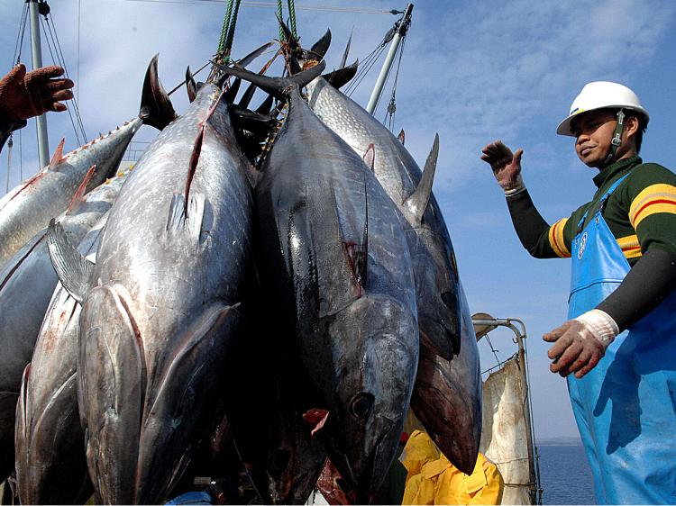
Scientific Committee in 2014 could not reach agreement on the upper bound for the TAC because of assessment uncertainties
Through Res. 15-04 ICAAT has set quotas at 16,142t (2015), 19,296t (2016) and 23,155t (2017)
For Western Atlantic Bluefin Tuna
20 year rebuilding program began in 1999 and will continue until 2018
Scientific advice in 2014 suggested a TAC of 1750t in light of the large uncertainties (lack of agreement on future stock productivity, lack of scientific surveys and level of mixing with the eastern stock)
TAC set at 2,000t in each of 2015 and 2016 (Res. 2014-05)

Slide 70
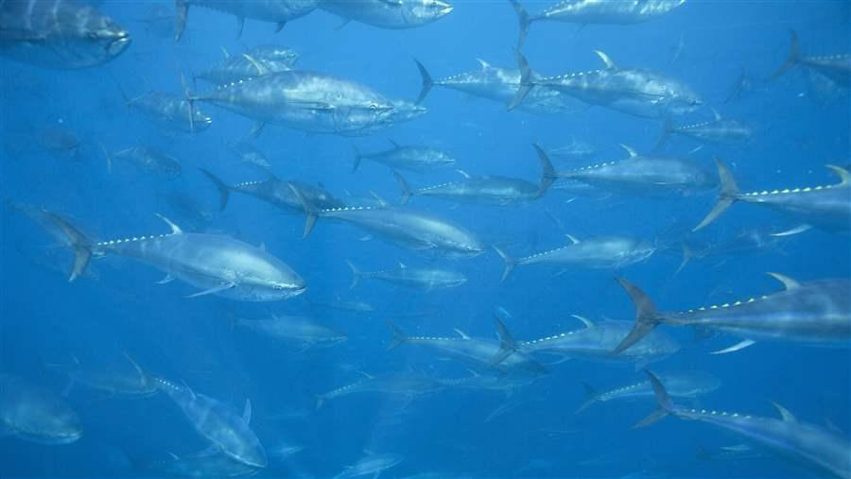
A Resolution (2015-12) on the Precautionary Approach was finally adopted in 2015 which provides “the Commission should apply a precautionary approach” (emphasis added)
An ICAAT Working Group has been working since 2012 to develop convention amendments and the latest draft suggests a very general version of the precautionary approach will be included (application of the precautionary approach to be in accordance with relevant internationally agreed standards)

Slide 71
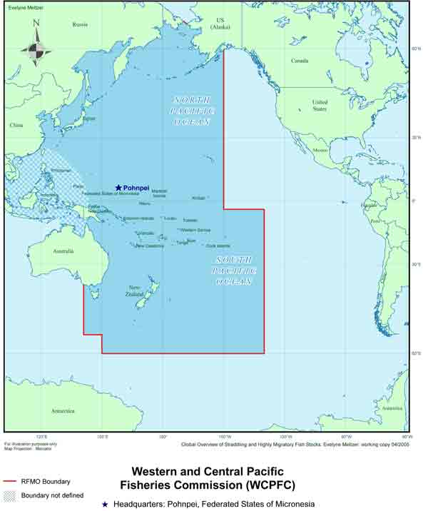
Western and Central Pacific Fisheries Commission and its management of Pacific bluefin tuna
The Convention on the Conservation and Management of Highly Migratory Fish Stocks in the Western and Central Pacific Ocean (opened for signature on 5 September 2000, in force 19 June 2004)
Post-UNFA
Commission members agree to apply the precautionary approach (Art. 5)
Commission is mandated to determine stock-specific reference points based on the best scientific information available (Art. 6)

Slide 72
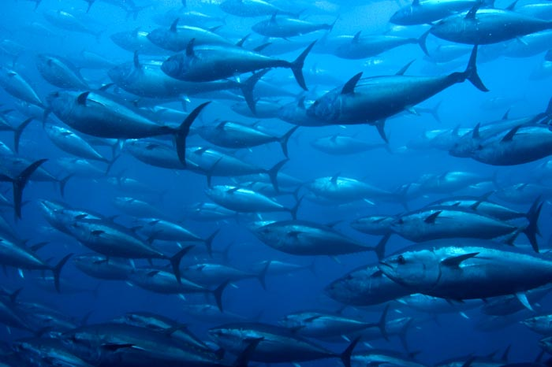
Scientists have assessed the Pacific bluefin stock to be near historically low levels and heavily overfished with depletion to some 4% of unfished levels
Reaching agreement on reference points has not been possible
Only a provisional Multi-Annual Rebuilding Plan has been adopted (Conservation and Management Measure 2015-04)
Sets an initial goal of rebuilding the stock spawning biomass to historical median (42,592t) within 10 years
Requires taking measures necessary to reduce the total fishing efforts by fishing vessels to stay below 2002-2004 annual average levels

Slide 73
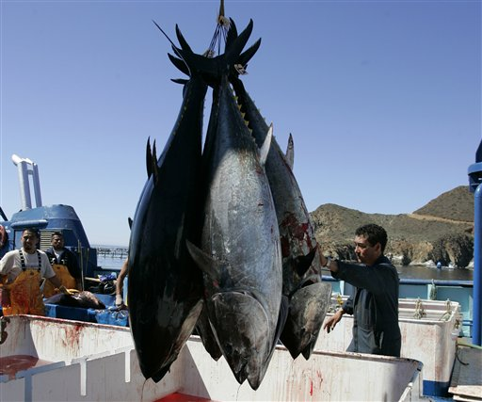
Requires reduction of juvenile catches (less than 30 kg) to be 50% below the 2002-2004 annual average levels
Mandates the Northern Committee (NC) to develop reference points at its 2015 and 2016 meetings
Quorum for 2015 NC meeting not achieved and at informal discussions, Canada expressed its disappointment with the lack of progress on the management of Pacific Bluefin
At September 2016 NC meeting, participants could not agree on a limit reference point or other elements for a precautionary management framework for the stock

Slide 74
Concluding Cautions about Precaution
The Precautionary Principle/Approach Is Not a Panacea (A “Quick Fix” to the World’s Legal, Policy and Practical Woes)
Does not fill the numerous global “governance gaps”, e.g.,
No convention on land-based pollution/activities (“soft” Global Programme of Action for the Protection of the Marine Environment from Land-Based Activities, 1995)
No comprehensive convention on sea-bed activities (MARPOL 73/78 only covers oily platform drainage [not to exceed 15 ppm] and garbage disposal from rigs [no disposal except for ground food wastes if more than 12 nm from land]
No comprehensive chemicals convention
No integrated management arrangements for the high seas

Slide 75
Does not fix weak international environmental standards that exist, for example
Sewage from ships
MARPOL Convention’s Annex IV continues an antiquated, non-precautionary distance from land approach
Allows ships to discharge comminuted and disinfected sewage (from approved systems) at a distance of more than 3 nautical miles from land
Allows sewage which is not comminuted or disinfected to be discharged at a distance of more than 12 nautical miles from land

Slide 76
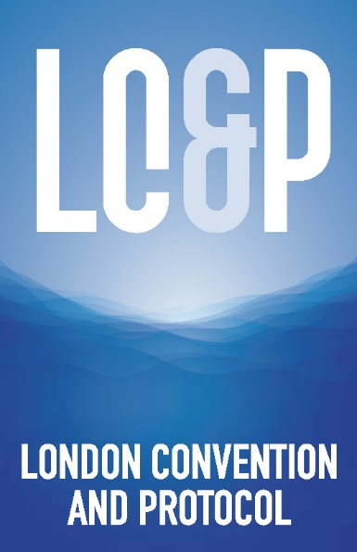
Does not ensure political will for countries to adopt and implement international agreements promoting the precautionary approach, e.g.,
1996 Protocol to the London Convention
Only 47 Contracting Parties as of 1 November 2016
1995 UN Fish Stocks Agreement
Only 83 Parties as of 1 November 2016

Slide 77
Does not “swim alone”
Numerous other principles of sustainable development must also be put into practice
Those principles include
The ecosystem approach
Public participation
Social equity
Intergenerational equity
Integration (Especially integrated coastal and ocean management)
Polluter pays
Environmental impact assessment
Pollution prevention
Nevertheless, Precaution Continues To Be a Fundamental Principle and Aspirational Beacon in the Global Quest for Sustainable Seas and Healthy Coastal Communities!

